Slide 1



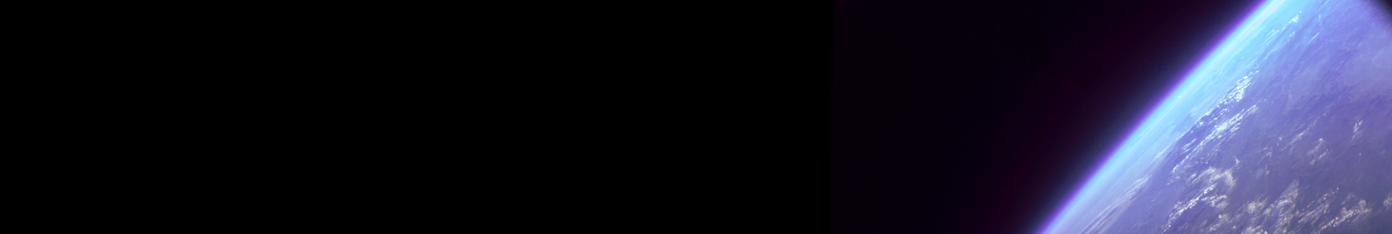
Investigating the Relationship Between Planet Occurrence and Host Star Metallicity
Adrienne Vescio, Patrick Young
School of Earth and Space Exploration, Arizona State University
Arizona NASA Space Grant Symposium | April 17th, 2021
avescio@asu.edu

Slide 2
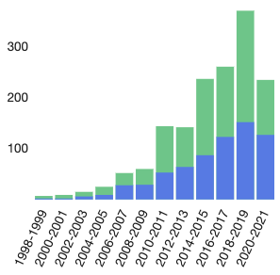

Motivation
The search for exoplanets has historically been intertwined with efforts to understand the factors that drive occurrence rates
Raghavan et al. 2010 (A Survey of Stellar Type Families: Multiplicity of Solar Type Stars)
Petigura et al. 2018 (The California-Kepler Survey IV. Metal Rich Stars Host a Greater Diversity of Planets)
This project relates to this effort, searching to link a visible divide of stellar populations as shown when comparing metallicity ratios to the occurrence rate of exoplanets.
NASA/ADS
By studying this relationship, we grow a greater understanding of the link between fundamental building blocks in the protoplanetary disk and planetary formation!
NASA/ADS
avescio@asu.edu

Slide 3
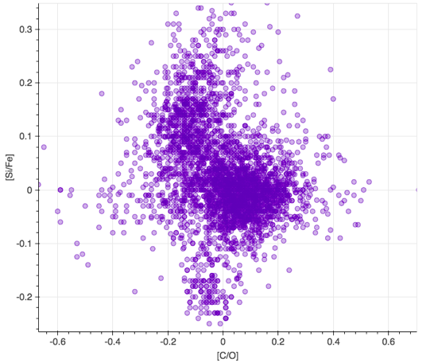
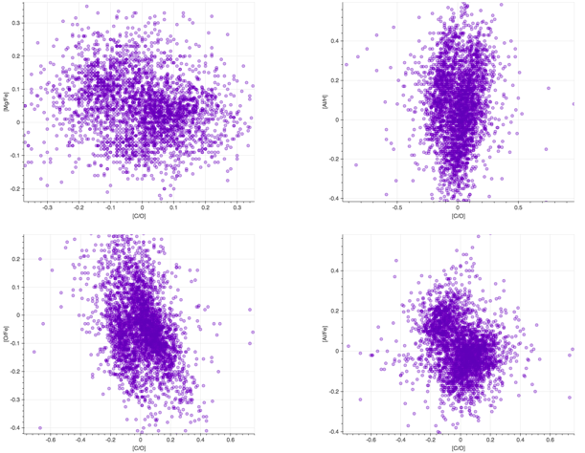
avescio@asu.edu
Hypatia Catalog

Slide 4
Methods
What observable differences can we determine between the separations?
What implications do these separations in stellar population and their corresponding differences in exoplanet occurrence have on the formation of planetary systems?
Pull exoplanet data from the NASA Exoplanet Archive
Separate lobes by eye using Hypatia Catalog
Create exoplanet statistics
Compare results to manual results to confirm conclusions
Run machine learning algorithms
avescio@asu.edu

Slide 5
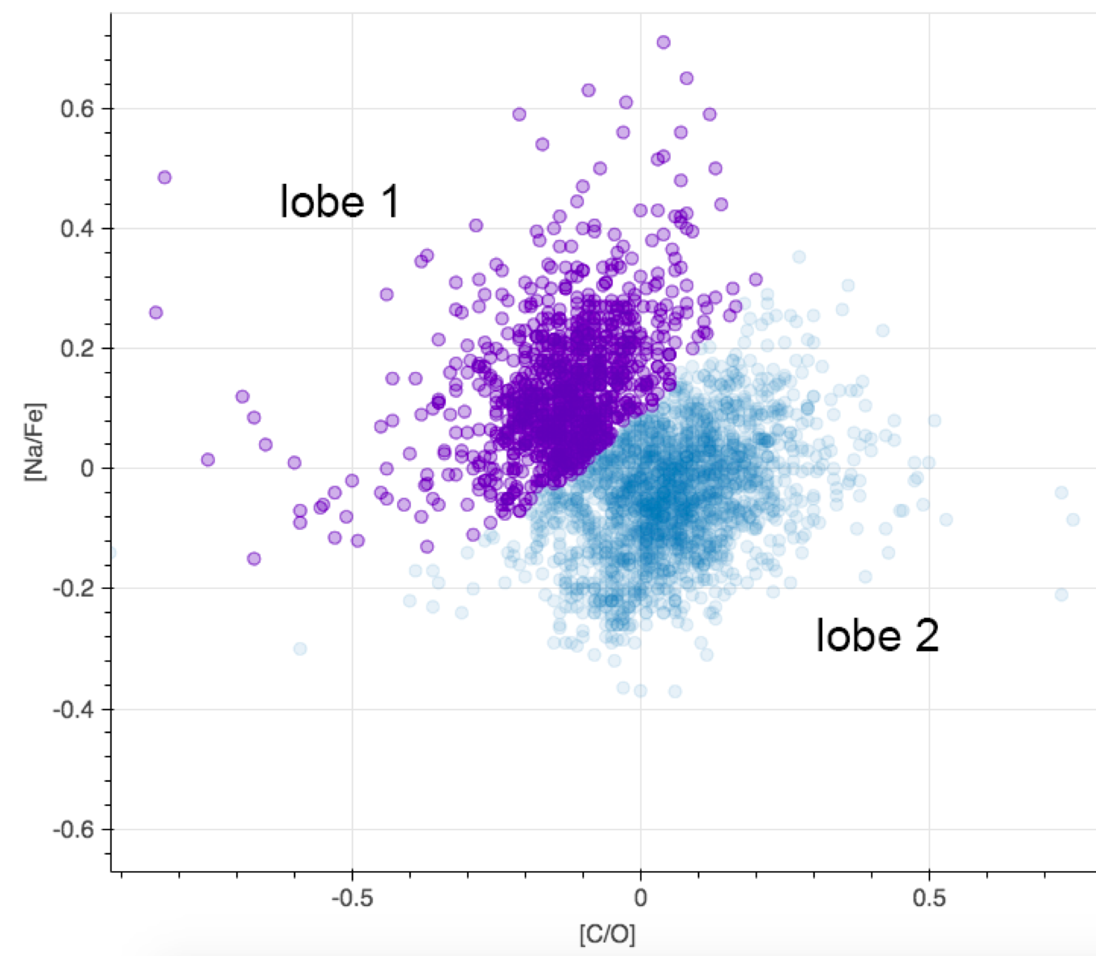
Results
For all plots, we observe a general pattern where one “lobe” will contain more than double the percentage of planet hosts.
We generally did not observe a large, consistent difference in the number of planets per system from “lobe” to “lobe”
Plots containing the following elements showed this pattern: C, O (we most commonly see this pattern where we compare with [C/O]), Na, Mg, Al, Fe, Si
Hypatia Catalog
avescio@asu.edu

Slide 6
Further Work & Conclusions
Complete machine learning separation analysis for confirmation of results
See if the results change/apply to more plots when we separate the population into 3+ regions as opposed to only two
Determine potential causes for clumping in metallicity ratios of the stellar population
Search for other potential impacts of separations (such as occurrence of multi-star systems and planetary system architecture, which has implications on the longevity of systems-- or rather, the likelihood of having developed and intelligent life)
In an investigation of a visual separation in plots comparing stellar abundance ratios, we found that one “lobe” consistently has double the occurrence rate than the other. This separation was observed in plots comparing abundances of C, O, Na, Mg, Al, Fe, and Si.
avescio@asu.edu

Slide 7
Questions?
In an investigation of a visual separation in plots comparing stellar abundance ratios, we found that one “lobe” consistently has double the occurrence rate than the other. This separation was observed in plots comparing abundances of C, O, Na, Mg, Al, Fe, and Si.
avescio@asu.edu

Slide 8
Acknowledgements
The material contained in this document is based upon work supported by a National Aeronautics and Space Administration (NASA) grant or cooperative agreement. Any opinions, findings, conclusions or recommendations expressed in this material are those of the author and do not necessarily reflect the views of NASA. This work was supported through a NASA grant awarded to the Arizona/NASA Space Grant Consortium.
This research has made use of the NASA Exoplanet Archive, which is operated by the California Institute of Technology, under contract with the National Aeronautics and Space Administration under the Exoplanet Exploration Program.
The research shown here acknowledges use of the Hypatia Catalog Database, an online compilation of stellar abundance data as described in Hinkel et al. (2014, AJ, 148, 54), which was supported by NASA's Nexus for Exoplanet System Science (NExSS) research coordination network and the Vanderbilt Initiative in Data-Intensive Astrophysics (VIDA).
Footer images used on title/conclusion slides courtesy of NASA Space Grant.
avescio@asu.edu

